Slide 1


Airbnb Listing Analysis
IN Beijing & Boston
Team 4, Cohort B, MSBA’20
Xiaohan Mei, Yuhong Lu, Ziyan Pei,
Peng Yuan, Mengqing Zhang, Jiayuan Zou

Slide 2

CONTENTS
Study Problems &
Methods
Dataset Description &
Exploratory Data Analysis
Pricing Modeling &
Text Analysis
Results &
Conclusion

Slide 3

01
Study Problem & Methods

Slide 4
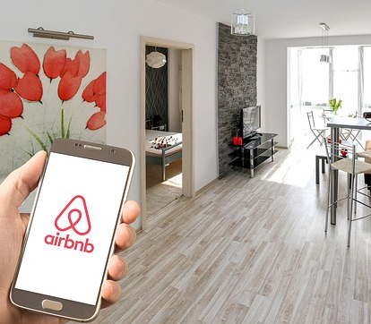
Study Problem
Setting, and why it is Important
Comparison of demand and supply between Airbnb homestays in Beijing and Boston
Establishing a supervised machine learning model of housing price
Implementing unsupervised machine learning models to build Airbnb homeowners(hosts) and customers(visitors) profiles

Slide 5

Hope to Get
Setting, and why it is Important
External differences in the Airbnb marketplaces between China & the United States
Reference opinions for homestay hosts in the pricing area
Relevant factors that affect the preferences of Airbnb consumers in China and the United States
Comparative analysis of the competitor of Airbnb (booking.com)

Slide 6


Beijing
Capital of China
Northeastern of China
Snow in winter, hot in summer
Dense academic atmosphere
(busy around graduation season)
Why Beijing & Boston
Boston
Where the group members studying & living
Northeastern of the U.S
Snow in winter, hot in summer
Lots of universities and liberal arts college
(busy around graduation season)

Slide 7
Modeling
Main Methods
UML
SML
Web Crawler
Text Analysis to Comments & House Descriptions
Compare Airbnb with other pla6forms
Linear Regression
Lasso & Ridge Regression
Regression Tree & Random Forest
Boosting Model

Slide 8
02
Dataset Description &
Exploratory Data Analysis

Slide 9
Cleaning & Handling
Data Description
Three
sub-datasets
Reviews
Calender
Contain Reviews that Customers gave to the Homestays
Reports Pricing of the Listings at a Certain Date
Listings
Include Basic Information of the Room/House

Slide 10

Data Overview 01
3,501
Boston Listing Observations
Boston & Beijing listings
106 variables, includes the name , description, location, and review scores, etc.
Listings since Dec 2009 to Dec 2019.
25,921
Beijing Listing Observations
》

Slide 11

Data Overview 02
148,151 & 180,561
Boston & Beijing Reviews Observations
Boston & Beijing Reviews
9 variables, include listing names, reviews, date, etc.
Since Dec 2009 to Dec 2019.
Boston & Beijing Calendars
9 variables, report pricing and availability for the following year. Since Dec 2018 to Dec 2019.
2,269,205 & 9,461,165
Boston & Beijing Calendar Observations
》

Slide 12
Missing Values Analysis
Data Cleaning
Transfer Text Information and Categorical Variables into Dummies
Remove observations if total # of N/A < 5%
Use Mean Based on Neighborhoods and Types of Houses to Replace N.A for Review Scores, Host Response Time/Rate, Security Deposit and Cleaning Fee
Shrink Geographic Scope of Beijing Dataset into ‘5-Ring’ Areas, excludes Villages and Country

Slide 13

Data Cleaning
0.1
42
60
Revised Data
%
%
%
Boston Listings Data – 0.1% less observations Beijing Listings Data – 42% less observations
Variables – From 106 to 42 variables

Slide 14
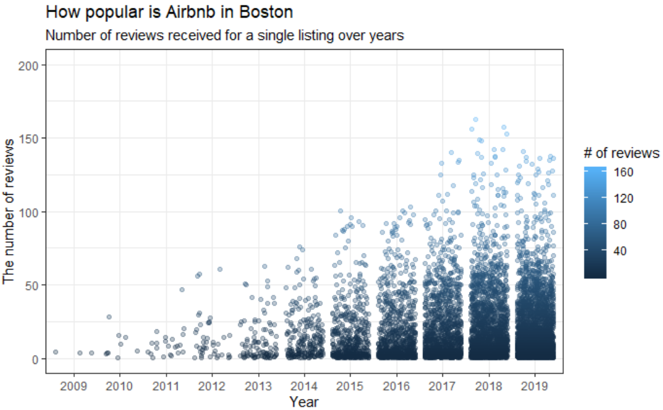
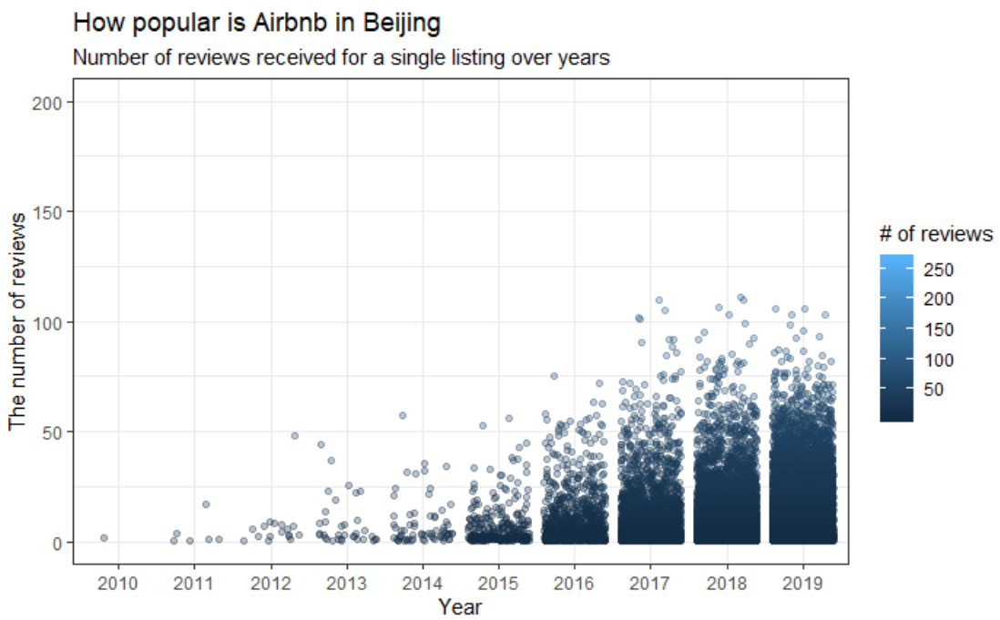
2009
Exploratory Data Analysis
Popularity of Airbnb Across Years
Measured by the number of comments made by customers.
2019

Slide 15

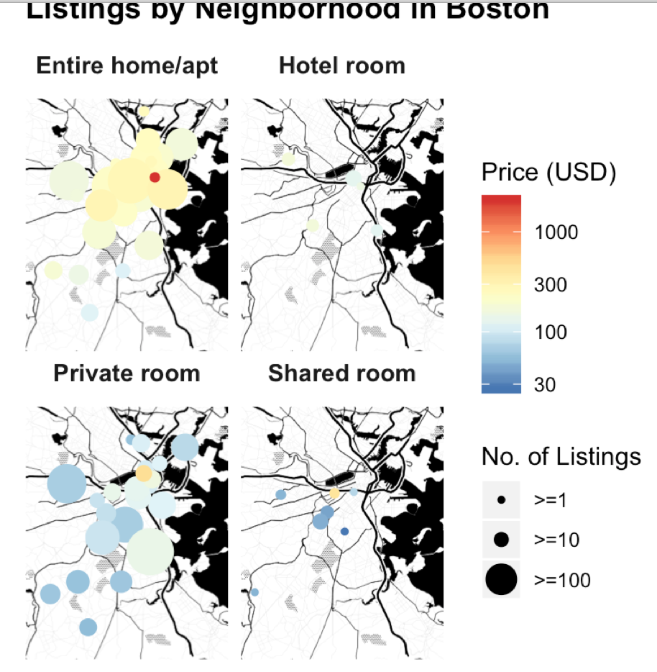
Boston
Exploratory Data Analysis
Price & # of Listings

Slide 16
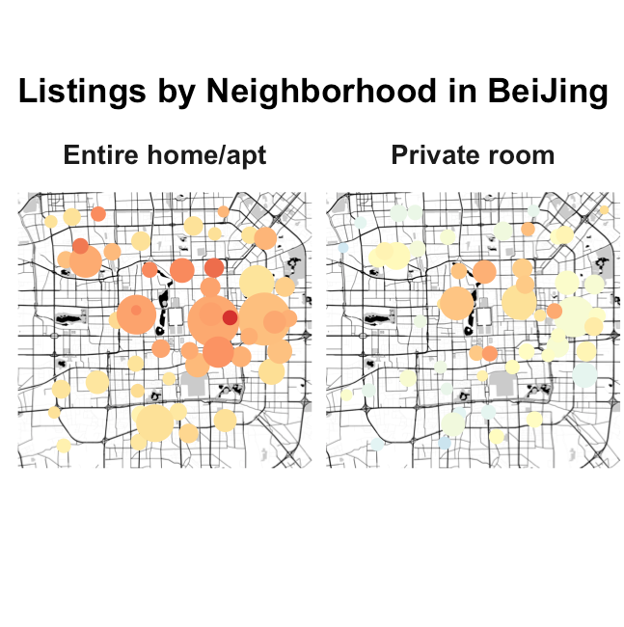

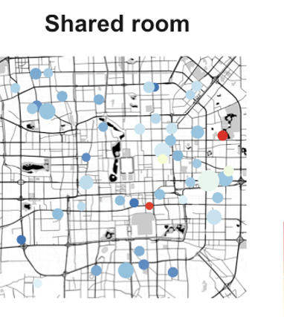
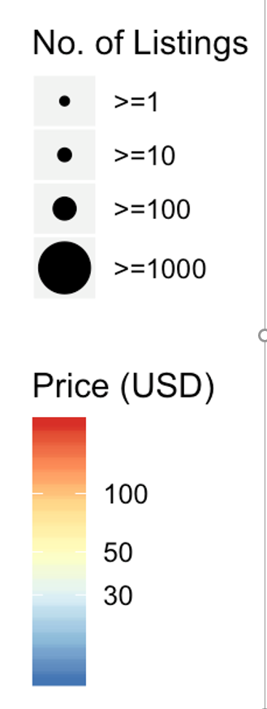
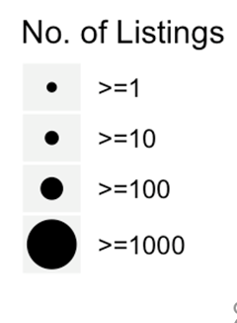
Beijing
Exploratory Data Analysis
Price & # of Listings

Slide 17
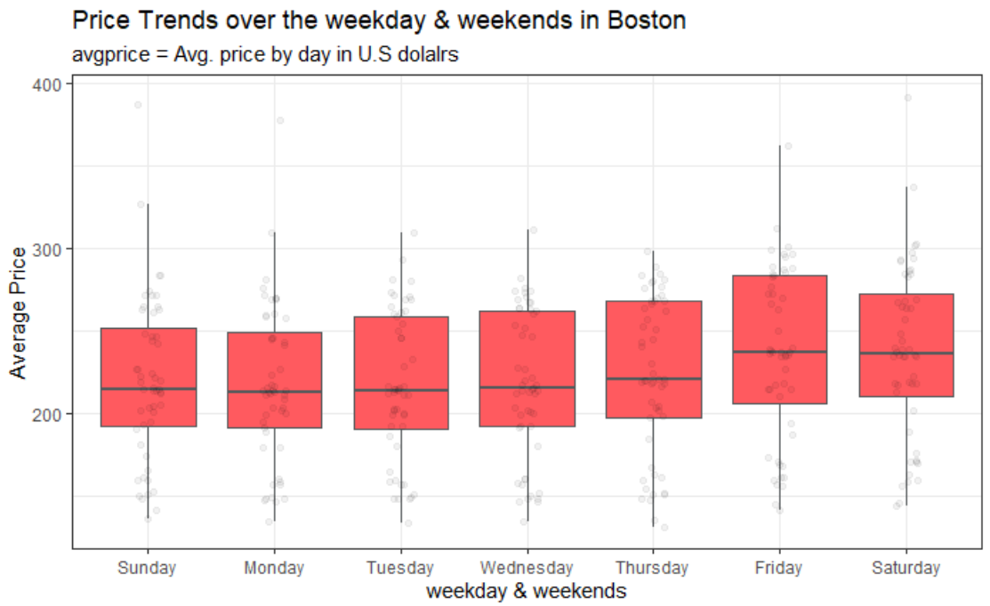
Exploratory Data Analysis
Price Trends over the Weeks
Boston

Slide 18
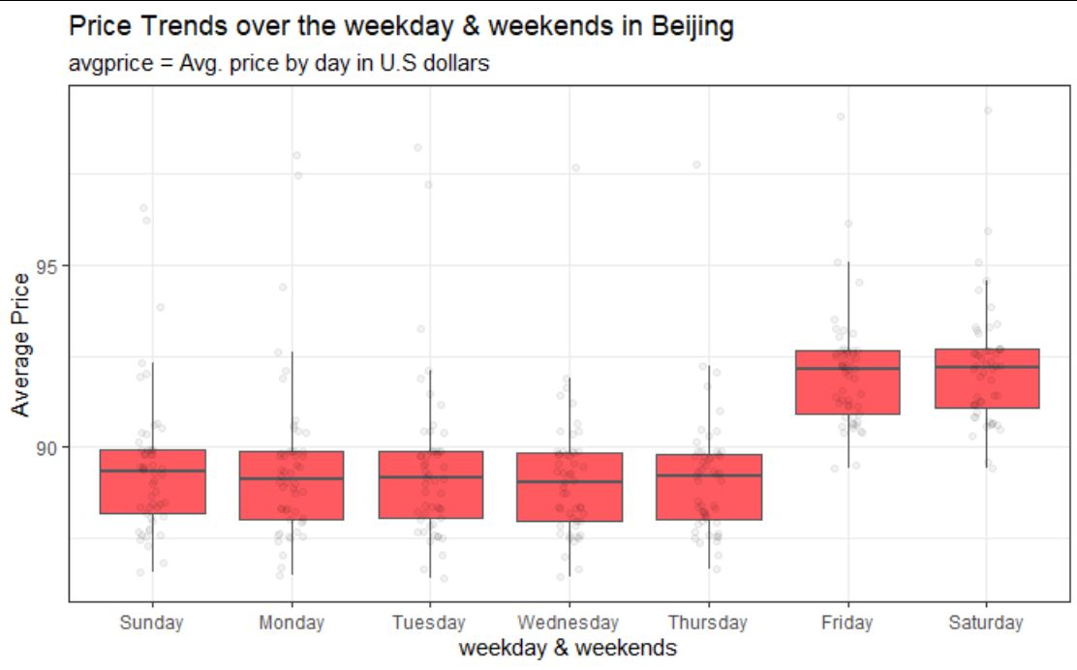
Exploratory Data Analysis
Price Trends over the Weeks
Beijing

Slide 19
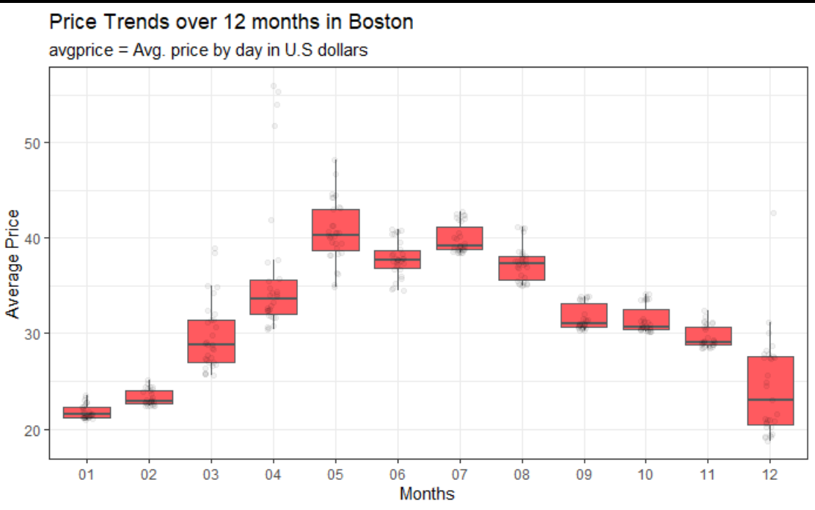
Exploratory Data Analysis
Price Trends over Seasons
Boston

Slide 20
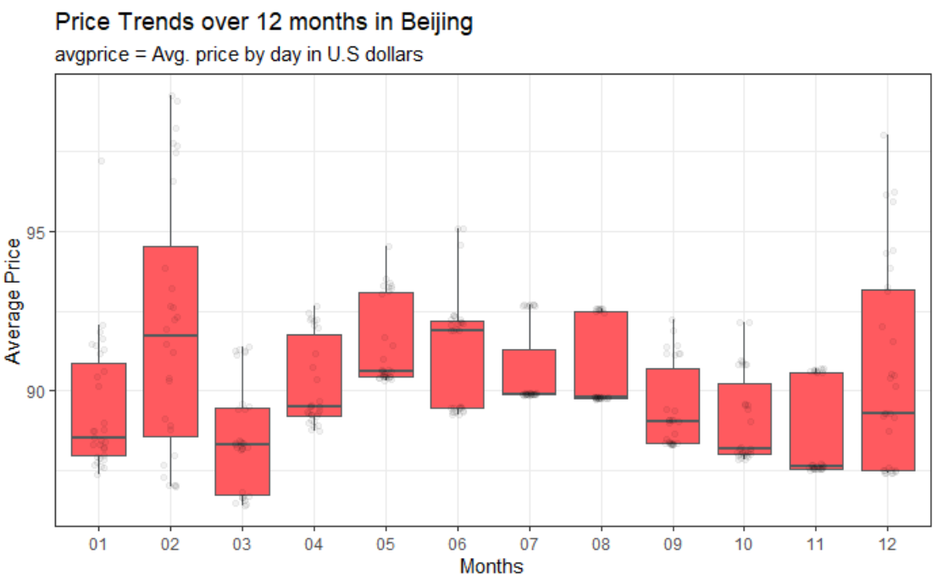
Exploratory Data Analysis
Price Trends over Seasons
Beijing

Slide 21
03
Price Modeling

Slide 22
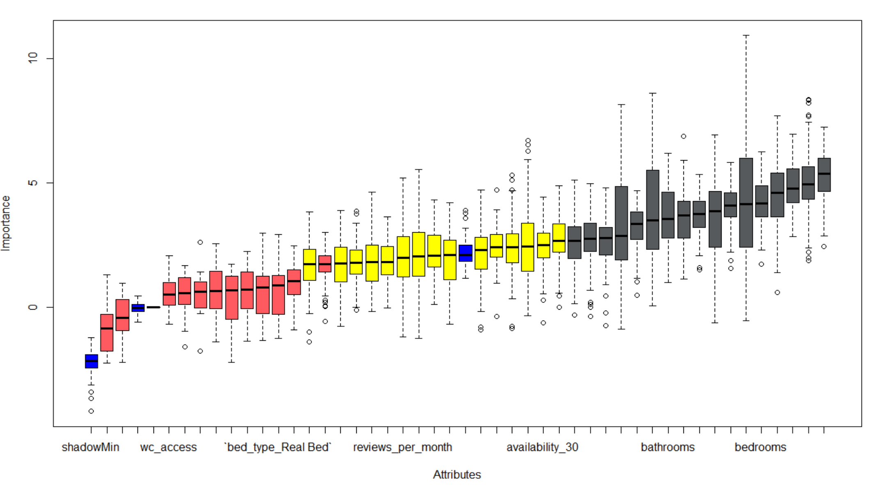
Boruta
Feature Selection

Slide 23





Important Variables 01
Host Listings Owned
Neighborhoods
Accommodates
Bathrooms
Bedrooms
Beds
Cleaning Fee
Guests Included
Price for Extra People
Maximum Nights Stay
Number of Reviews
WIFI Availability
Peds Allowance
Host Response Time – No Records
Host Response Time – A Few Hours
Host Cancellation Policy - Strict
Boston

Slide 24
Important Variables 02
Host Listing Owned
Neighborhoods
Accommodates
Bathrooms
Bedrooms
Beds
Guests Included
Minimum Nights Stay
Availability For 30 Days
Availability For 90 Days
Availability For 365 Days
Number of Reviews
TV Availability
Wheelchair Access
Room Type – Shared Room
Beijing

Slide 25
04
Text Analysis

Slide 26
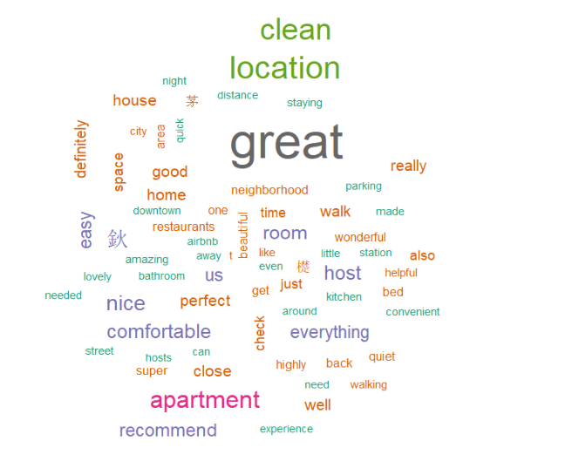
NLP Analysis
Text Exploratory
Boston

Slide 27
Thank You!
Team 4, Cohort B, MSBA’20
Xiaohan Mei, Yuhong Lu, Ziyan Pei,
Peng Yuan, Mengqing Zhang, Jiayuan Zou

